Slide 1
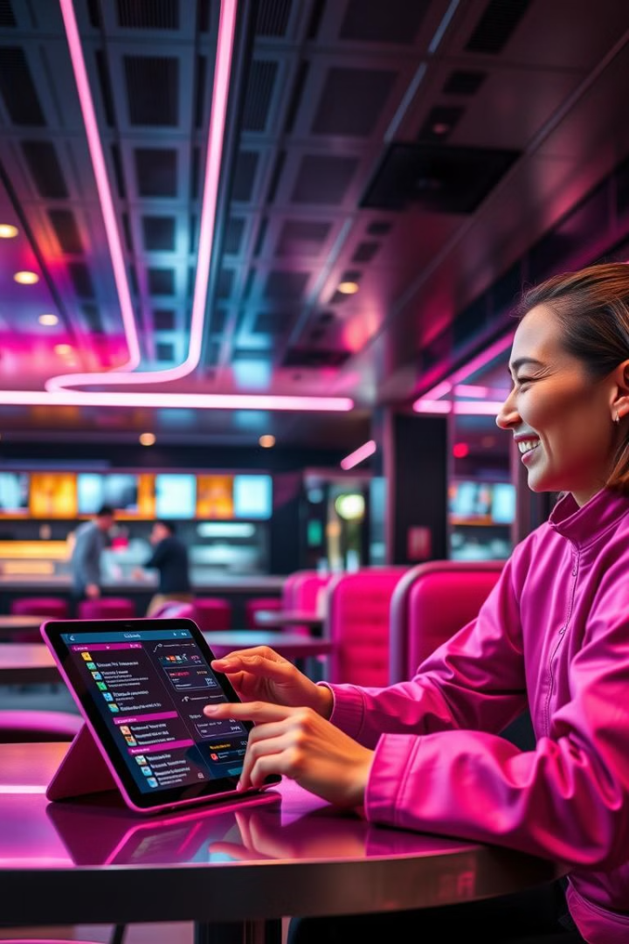
NoWait: The Future of Contactless Dining
No Wait is a revolutionary digital dining solution that eliminates the need for traditional waitstaff while enhancing the customer experience.
by Ramanuj Ladda

Slide 2
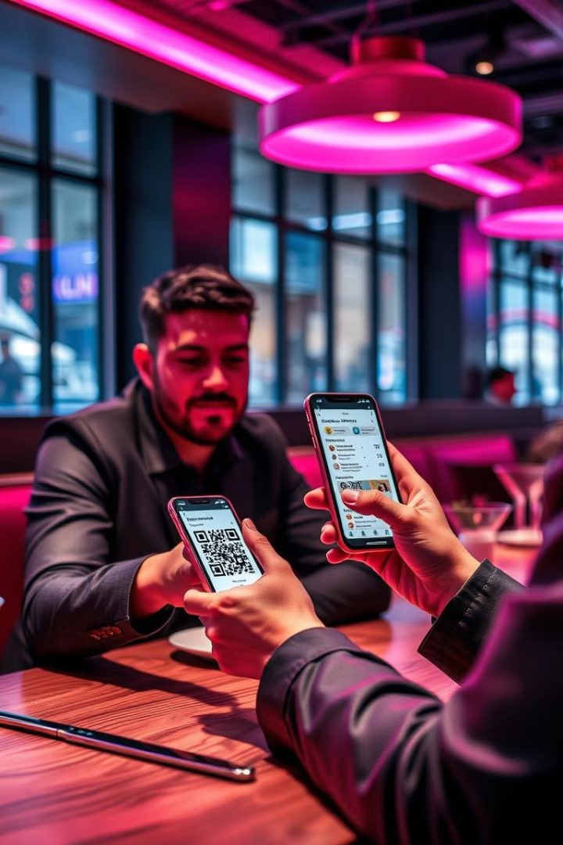
What is NoWait?
No Wait is a web-based app that customers access by scanning a QR code at their table.
Menu Experience
Customers can browse the menu, place orders, and receive real-time updates.
Interactive Features
No Wait offers a unique set of features to elevate both customer satisfaction and operational efficiency.

Slide 3
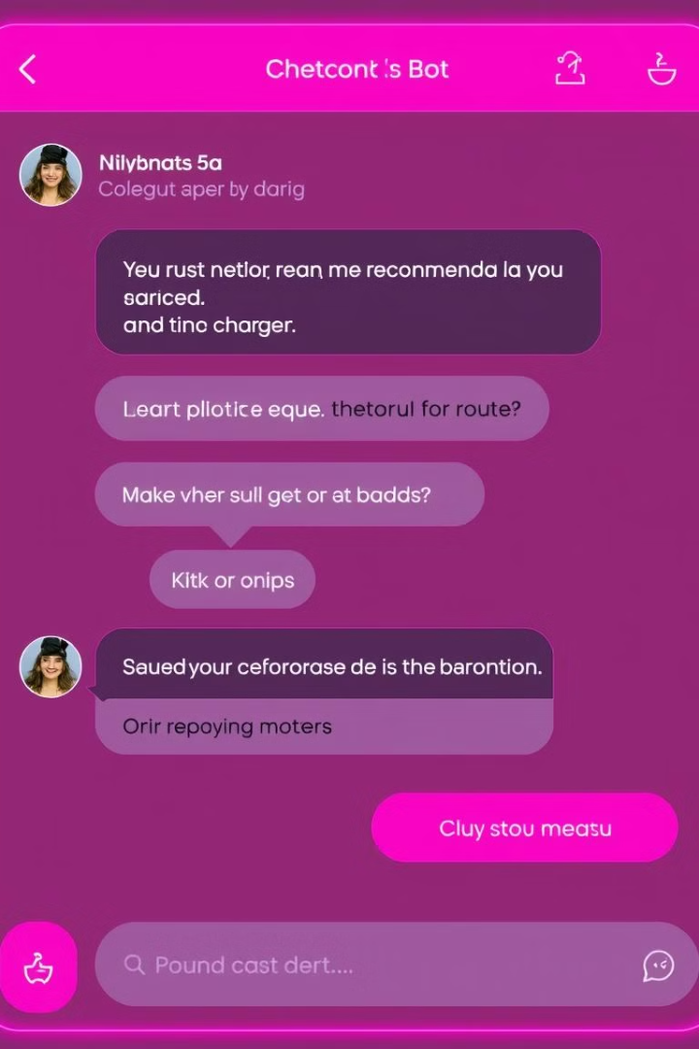
Intelligent Chatbot
The heart of No Wait is an AI-driven, intelligent chatbot that makes ordering a breeze.
1
Menu Guidance
The chatbot assists customers with menu guidance and provides personalized recommendations.
2
Customer Reviews
Guests can easily leave feedback, giving restaurants real-time insights into customer satisfaction.
3
Order History
The chatbot remembers each customer’s order history, enabling personalized recommendations.
4
Food Preparation Time
The chatbot provides real-time estimates on preparation times, managing expectations and reducing wait-related frustrations.

Slide 4
Upselling and Personalization
The AI-powered chatbot provides personalized upselling opportunities, suggesting high-margin items, add-ons, and exclusive pairings.
Increased Revenue
Personalized Experience
Encourages customers to enhance their meals and improve the restaurant’s revenue.
The chatbot learns customer preferences and suggests items tailored to their tastes.

Slide 5




Contactless and Hygienic Dining
No Wait ensures a fully contactless solution, meeting modern hygiene standards while providing an innovative, touch-free dining experience.
QR Code Scanning
Digital Ordering
Contactless Payment
Customers access the No Wait app by scanning a QR code at their table.
Customers place orders directly through the app, eliminating the need for physical menus or interaction with waitstaff.
Customers can pay for their meals through the app, further reducing physical contact.

Slide 6
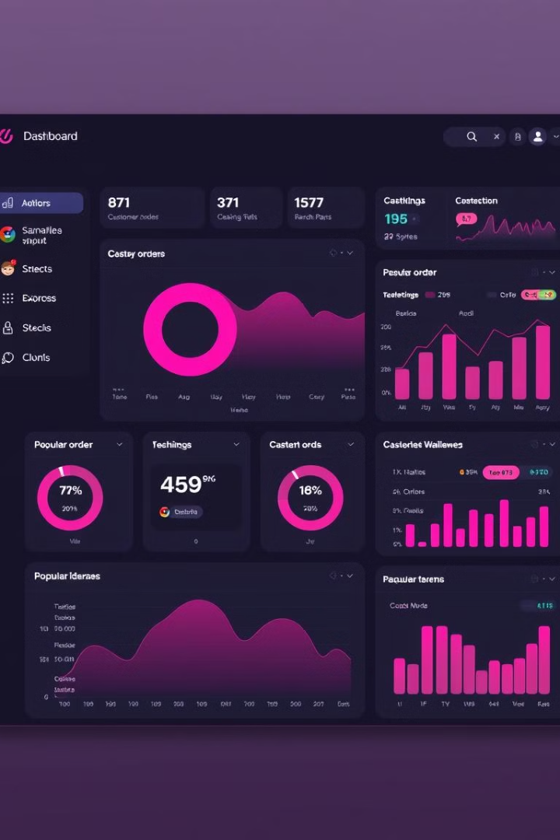
Data-Driven Insights
No Wait empowers restaurants by offering data-driven insights on popular menu items, customer preferences, and ordering patterns.
Menu Updates
Promotions
Service Improvements
Data-backed decisions on menu updates, promotions, and service improvements.
Data-backed decisions on menu updates, promotions, and service improvements.
Data-backed decisions on menu updates, promotions, and service improvements.

Slide 7




Unique Selling Points
No Wait is more than just another dining tool; it's a personalized experience that reflects your restaurant's personality.
Expert-Led Development
I am personally invested in delivering customized experiences that ensure you get an edge over competitors.
Real-Time Data-Driven Insights
Gain insights into customer preferences and behavior, empowering your team to make informed, strategic decisions.
Future-Proofing with Competitive Edge
Stay competitive by embracing No Wait to keep your restaurant at the forefront of customer expectations.

Slide 8
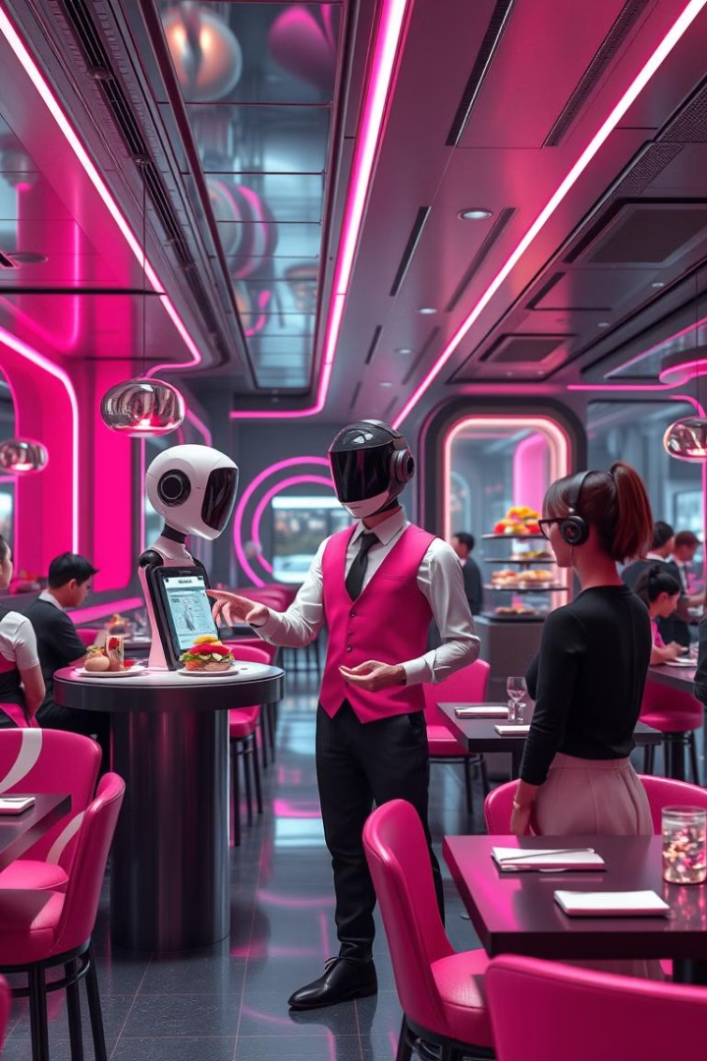
Future Vision for NoWait
We’re constantly exploring future enhancements to bring even more innovation to dining.
1
Interactive 3D Waiter
Imagine a realistic, AI-driven virtual waiter that can greet customers, offer menu guidance, and provide a personalized service experience.
2
3D Food Models
Future updates could include interactive 3D models of dishes, allowing customers to zoom in, rotate, and explore each item visually.
3
Augmented Reality (AR) Options
Imagine customers using their phone cameras to visualize dishes on the table in real-time.

Slide 9

Pricing
A license for No Wait costs ₹69,999 per year, offering an affordable entry point to groundbreaking technology with unlimited potential.
Streamline Operations
Improve Customer Experiences
Drive Additional Revenue
Reduce labor costs and improve efficiency.
Enhance customer satisfaction and loyalty.
Increase ticket sizes and boost profitability.

Slide 10

Why Choose NoWait?
No Wait is not only about elevating your service but also about staying competitive.
1
Keep Up with Industry Trends
2
Gain a Data-Driven Edge
3
Create a Lasting Impression
This is your opportunity to set a new standard for modern dining and make a memorable impression on customers.
Data-informed businesses are positioned for sustained success.
The combination of interactive features, intelligent chatbot assistance, and a sleek, custom-branded interface ensures that every customer’s experience is memorable.

